Slide 1
Sharing

Slide 2
Sharing simplify
.include "linux.s"
.section .data
helloworld:
.ascii "hello world\n"
helloworld_end:
.equ helloworld_len, helloworld_end - helloworld
.section .text
.globl _start
_start:
movl $STDOUT, %ebx
movl $helloworld, %ecx
movl $helloworld_len, %edx
movl $SYS_WRITE, %eax
int $LINUX_SYSCALL
movl $0, %ebx
movl $SYS_EXIT, %eax
int $LINUX_SYSCALL

Slide 3
Sharing simplify
.include "linux.s"
.section .data
helloworld:
.ascii "hello world\n"
helloworld_end:
.equ helloworld_len, helloworld_end - helloworld
.section .text
.globl _start
_start:
movl $STDOUT, %ebx
movl $helloworld, %ecx
movl $helloworld_len, %edx
movl $SYS_WRITE, %eax
int $LINUX_SYSCALL
movl $0, %ebx
movl $SYS_EXIT, %eax
int $LINUX_SYSCALL
.section .data
helloworld:
.ascii "hello world\n\0"
.section .text
.globl _start
_start:
pushl $helloworld
call printf
pushl $0
call exit

Slide 4
Sharing simplify
.include "linux.s"
.section .data
helloworld:
.ascii "hello world\n"
helloworld_end:
.equ helloworld_len, helloworld_end - helloworld
.section .text
.globl _start
_start:
movl $STDOUT, %ebx
movl $helloworld, %ecx
movl $helloworld_len, %edx
movl $SYS_WRITE, %eax
int $LINUX_SYSCALL
movl $0, %ebx
movl $SYS_EXIT, %eax
int $LINUX_SYSCALL
.section .data
helloworld:
.ascii "hello world\n\0"
.section .text
.globl _start
_start:
pushl $helloworld
call printf
pushl $0
call exit
delete
outsource

Slide 5
Sharing simplify
.include "linux.s"
.section .data
helloworld:
.ascii "hello world\n"
helloworld_end:
.equ helloworld_len, helloworld_end - helloworld
.section .text
.globl _start
_start:
movl $STDOUT, %ebx
movl $helloworld, %ecx
movl $helloworld_len, %edx
movl $SYS_WRITE, %eax
int $LINUX_SYSCALL
movl $0, %ebx
movl $SYS_EXIT, %eax
int $LINUX_SYSCALL
.section .data
helloworld:
.ascii "hello world\n\0"
.section .text
.globl _start
_start:
pushl $helloworld
call printf
pushl $0
call exit

Slide 6
Sharing delete
.include "linux.s"
.section .data
helloworld:
.ascii "hello world\n"
helloworld_end:
.equ helloworld_len, helloworld_end - helloworld
.section .text
.globl _start
_start:
movl $STDOUT, %ebx
movl $helloworld, %ecx
movl $helloworld_len, %edx
movl $SYS_WRITE, %eax
int $LINUX_SYSCALL
movl $0, %ebx
movl $SYS_EXIT, %eax
int $LINUX_SYSCALL
.section .data
helloworld:
.ascii "hello world\n\0"
.section .text
.globl _start
_start:
pushl $helloworld
call printf
pushl $0
call exit

Slide 7
Sharing delete
.section .data
helloworld:
.ascii "hello world\n"
.section .text
.globl _start
_start:
movl $STDOUT, %ebx
movl $helloworld, %ecx
movl $helloworld_len, %edx
movl $SYS_WRITE, %eax
int $LINUX_SYSCALL
movl $0, %ebx
movl $SYS_EXIT, %eax
int $LINUX_SYSCALL
.section .data
helloworld:
.ascii "hello world\n\0"
.section .text
.globl _start
_start:
pushl $helloworld
call printf
pushl $0
call exit

Slide 8
Sharing outsource
.section .data
helloworld:
.ascii "hello world\n"
.section .text
.globl _start
_start:
movl $STDOUT, %ebx
movl $helloworld, %ecx
movl $helloworld_len, %edx
movl $SYS_WRITE, %eax
int $LINUX_SYSCALL
movl $0, %ebx
movl $SYS_EXIT, %eax
int $LINUX_SYSCALL
.section .data
helloworld:
.ascii "hello world\n\0"
.section .text
.globl _start
_start:
pushl $helloworld
call printf
pushl $0
call exit

Slide 9
Sharing outsource
.section .data
helloworld:
.ascii "hello world\n"
.section .text
.globl _start
_start:
pushl $helloworld
call printf
movl $0, %ebx
movl $SYS_EXIT, %eax
int $LINUX_SYSCALL
.section .data
helloworld:
.ascii "hello world\n\0"
.section .text
.globl _start
_start:
pushl $helloworld
call printf
pushl $0
call exit

Slide 10
Sharing outsource
.section .data
helloworld:
.ascii "hello world\n"
.section .text
.globl _start
_start:
pushl $helloworld
call printf
movl $0, %ebx
movl $SYS_EXIT, %eax
int $LINUX_SYSCALL
.section .data
helloworld:
.ascii "hello world\n\0"
.section .text
.globl _start
_start:
pushl $helloworld
call printf
pushl $0
call exit

Slide 11
Sharing outsource
.section .data
helloworld:
.ascii "hello world\n"
.section .text
.globl _start
_start:
pushl $helloworld
call printf
movl $0, %ebx
movl $SYS_EXIT, %eax
int $LINUX_SYSCALL
.section .data
helloworld:
.ascii "hello world\n\0"
.section .text
.globl _start
_start:
pushl $helloworld
call printf
pushl $0
call exit

Slide 12
Sharing outsource
.section .data
helloworld:
.ascii "hello world\n"
.section .text
.globl _start
_start:
pushl $helloworld
call printf
pushl $0
call exit
.section .data
helloworld:
.ascii "hello world\n\0"
.section .text
.globl _start
_start:
pushl $helloworld
call printf
pushl $0
call exit

Slide 13
Sharing simplify
.section .data
helloworld:
.ascii "hello world\n"
.section .text
.globl _start
_start:
pushl $helloworld
call printf
pushl $0
call exit
.section .data
helloworld:
.ascii "hello world\n\0"
.section .text
.globl _start
_start:
pushl $helloworld
call printf
pushl $0
call exit

Slide 14
Sharing helloworld-nolib.s
.include "linux.s"
.section .data
helloworld:
.ascii "hello world\n"
helloworld_end:
.equ helloworld_len, helloworld_end - helloworld
.section .text
.globl _start
_start:
movl $STDOUT, %ebx
movl $helloworld, %ecx
movl $helloworld_len, %edx
movl $SYS_WRITE, %eax
int $LINUX_SYSCALL
movl $0, %ebx
movl $SYS_EXIT, %eax
int $LINUX_SYSCALL

Slide 15
Sharing helloworld-lib.s
.section .data
helloworld:
.ascii "hello world\n\0"
.section .text
.globl _start
_start:
pushl $helloworld
call printf
pushl $0
call exit
libc.so
(C Standard Library)
printf()
{
} exit()
{
}

Slide 16
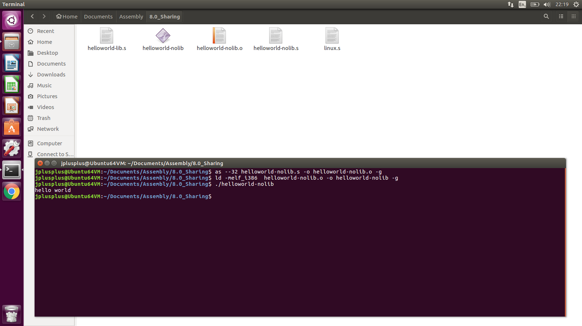
Sharing helloworld-nolib.s

Slide 17
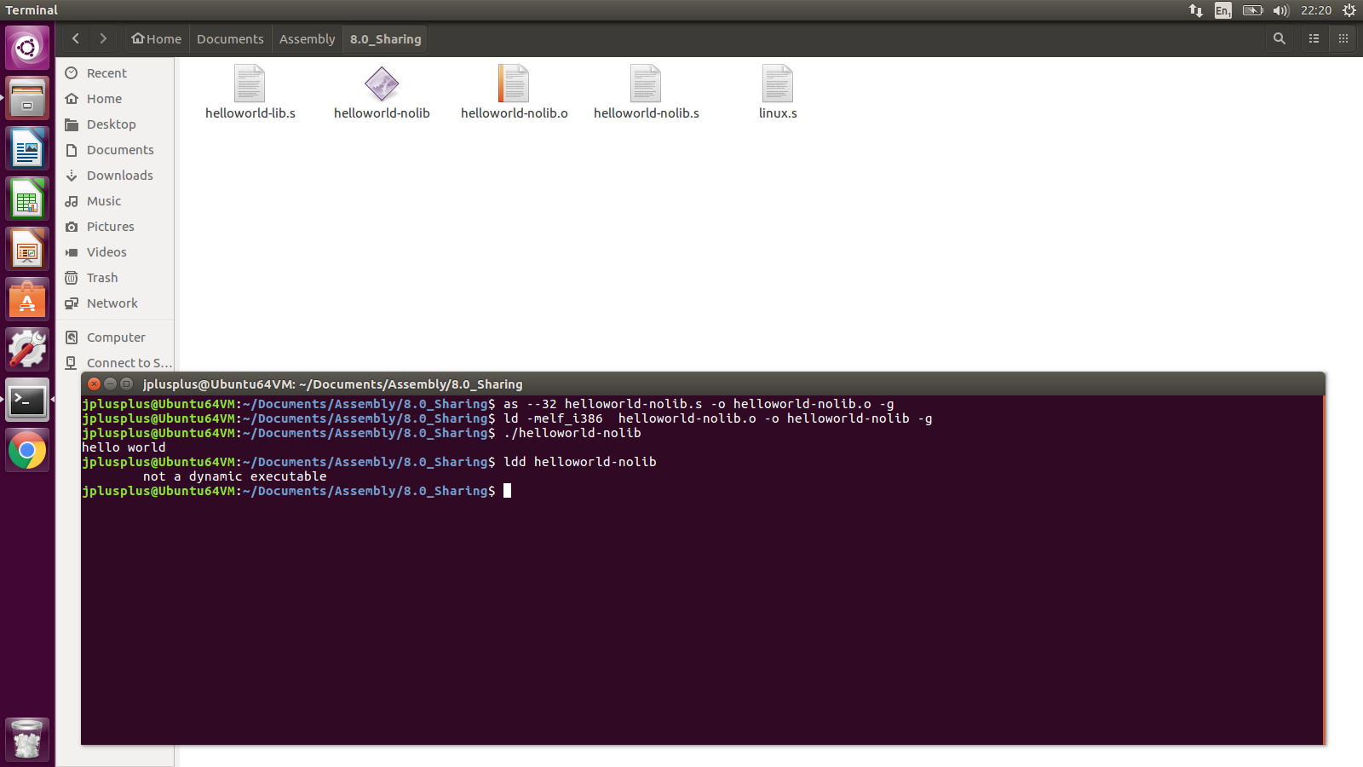
Sharing helloworld-lib.s

Slide 18
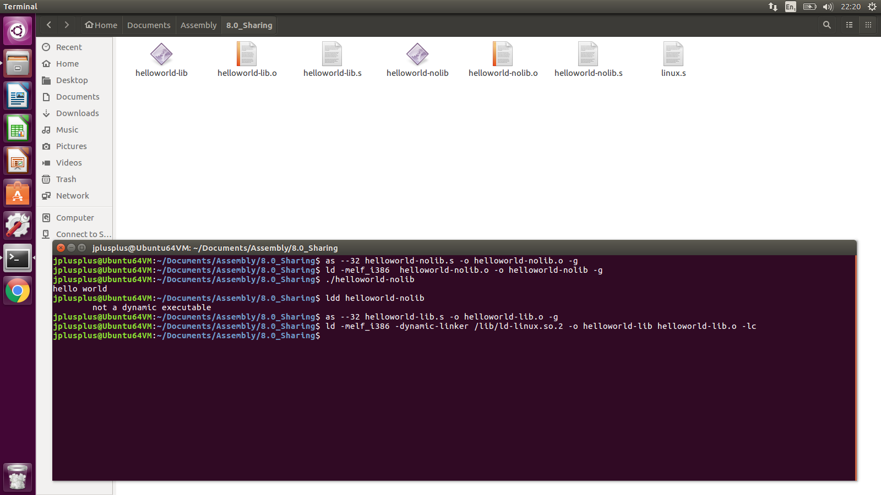
Sharing helloworld-lib.s

Slide 19
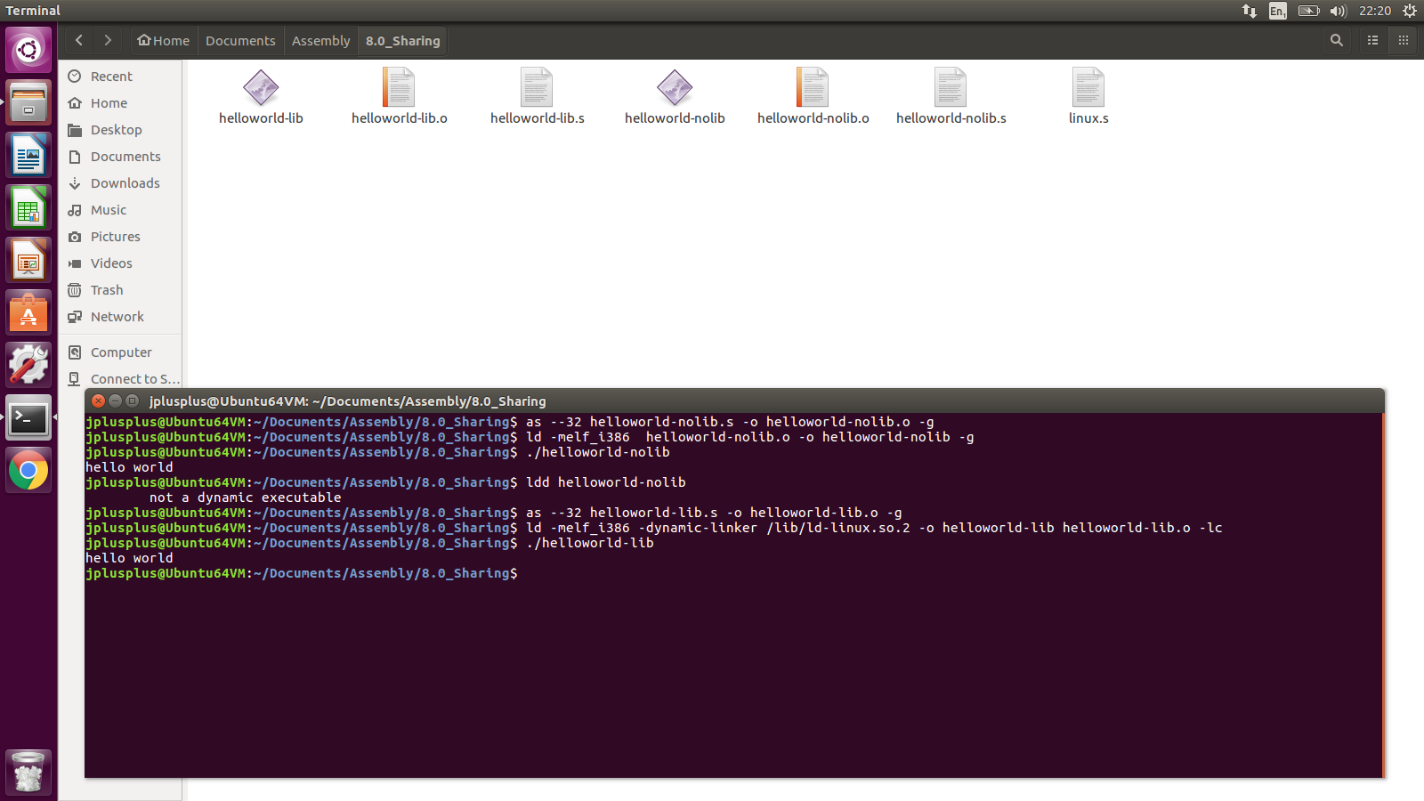
Sharing helloworld-lib.s

Slide 20

Sharing helloworld-lib.s
.section .data
helloworld:
.ascii "hello world\n\0"
.section .text
.globl _start
_start:
pushl $helloworld
call printf
pushl $0
call exit
4(%esp)$→$ | “helloworld-nolib”
(%esp)$→$ | 1
Terminal

Slide 21
Sharing helloworld-lib.s
.section .data
helloworld:
.ascii "hello world\n\0"
.section .text
.globl _start
_start:
pushl $helloworld
call printf
pushl $0
call exit
4(%esp)$→$ | “helloworld-nolib”
(%esp)$→$ | 1
Terminal

Slide 22
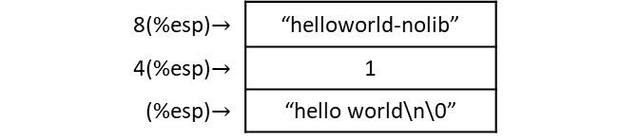
Sharing helloworld-lib.s
.section .data
helloworld:
.ascii "hello world\n\0"
.section .text
.globl _start
_start:
pushl $helloworld
call printf
pushl $0
call exit
8(%esp)$→$ | “helloworld-nolib”
4(%esp)$→$ | 1
(%esp)$→$ | “hello world\n\0”
Terminal

Slide 23
Sharing helloworld-lib.s
.section .data
helloworld:
.ascii "hello world\n\0"
.section .text
.globl _start
_start:
pushl $helloworld
call printf
pushl $0
call exit
8(%esp)$→$ | “helloworld-nolib”
4(%esp)$→$ | 1
(%esp)$→$ | “hello world\n\0”
Terminal
hello world

Slide 24
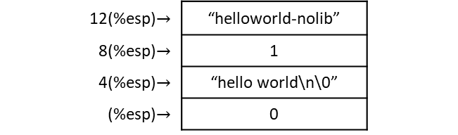
Sharing helloworld-lib.s
.section .data
helloworld:
.ascii "hello world\n\0"
.section .text
.globl _start
_start:
pushl $helloworld
call printf
pushl $0
call exit
12(%esp)$→$ | “helloworld-nolib”
8(%esp)$→$ | 1
4(%esp)$→$ | “hello world\n\0”
(%esp)$→$ | 0
Terminal
hello world

Slide 25
Sharing helloworld-lib.s
.section .data
helloworld:
.ascii "hello world\n\0"
.section .text
.globl _start
_start:
pushl $helloworld
call printf
pushl $0
call exit
12(%esp)$→$ | “helloworld-nolib”
8(%esp)$→$ | 1
4(%esp)$→$ | “hello world\n\0”
(%esp)$→$ | 0
Terminal
hello world

Slide 26
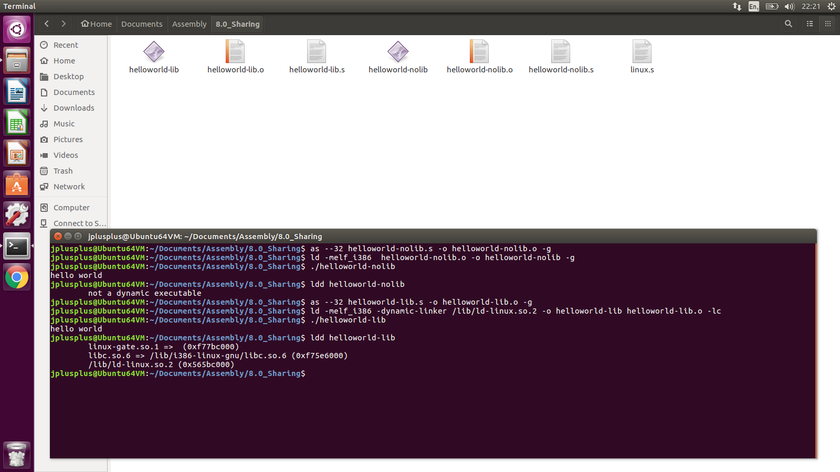
Sharing helloworld-lib.s

Slide 27
Sharing helloworld-lib.s
The program helloworld is linked to libc.so.6 (shared object libc version 6)

Slide 28
Sharing helloworld-lib.s
The program helloworld is linked to libc.so.6 (shared object libc version 6)

Slide 29
Sharing helloworld-lib.s
The program helloworld is linked to libc.so.6 (shared object libc version 6)

Slide 30
Sharing helloworld-lib.s
The program helloworld is linked to libc.so.6 (shared object libc version 6)
libc.so.6 is found at /lib/i386-linux-gnu/libc.so.6

Slide 31
Sharing helloworld-lib.s
The program helloworld is linked to libc.so.6 (shared object libc version 6)
libc.so.6 is found at /lib/i386-linux-gnu/libc.so.6
/lib/ld-linux.so.2 is found at /lib/ld-linux.so.2.

Slide 32
Sharing length of string
.section .data
helloworld:
.ascii "hello world\n\0"
.section .text
.globl _start
_start:
pushl $helloworld
call printf
pushl $0
call exit
.section .data
helloworld:
.ascii "hello world\n"
.section .text
.globl _start
_start:
movl $STDOUT, %ebx
movl $helloworld, %ecx
movl $helloworld_len, %edx
movl $SYS_WRITE, %eax
int $LINUX_SYSCALL
movl $0, %ebx
movl $SYS_EXIT, %eax
int $LINUX_SYSCALL
8(%esp)$→$ | “helloworld-nolib”
4(%esp)$→$ | 1
(%esp)$→$ | “hello world\n\0”
Terminal
hello world
You might notice that we didn’t push the length of the string. printf looks for null character (\0) to know end of string

Slide 33
Sharing length of string
.section .data
helloworld:
.ascii "hello world\n\0"
.section .text
.globl _start
_start:
pushl $helloworld
call printf
pushl $0
call exit
.section .data
helloworld:
.ascii "hello world\n"
.section .text
.globl _start
_start:
movl $STDOUT, %ebx
movl $helloworld, %ecx
movl $helloworld_len, %edx
movl $SYS_WRITE, %eax
int $LINUX_SYSCALL
movl $0, %ebx
movl $SYS_EXIT, %eax
int $LINUX_SYSCALL
8(%esp)$→$ | “helloworld-nolib”
4(%esp)$→$ | 1
(%esp)$→$ | “hello world\n\0”
Terminal
hello world
You might notice that we didn’t push the length of the string. printf looks for null character (\0) to know end of string

Slide 34
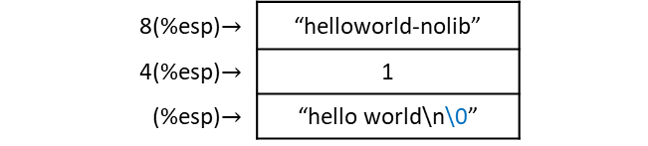
Sharing length of string
.section .data
helloworld:
.ascii "hello world\n\0"
.section .text
.globl _start
_start:
pushl $helloworld
call printf
pushl $0
call exit
.section .data
helloworld:
.ascii "hello world\n"
.section .text
.globl _start
_start:
movl $STDOUT, %ebx
movl $helloworld, %ecx
movl $helloworld_len, %edx
movl $SYS_WRITE, %eax
int $LINUX_SYSCALL
movl $0, %ebx
movl $SYS_EXIT, %eax
int $LINUX_SYSCALL
8(%esp)$→$ | “helloworld-nolib”
4(%esp)$→$ | 1
(%esp)$→$ | “hello world\n\0”
Terminal
hello world
You might notice that we didn’t push the length of the string. printf looks for null character (\0) to know end of string

Slide 35
Sharing indefinite # of parameters
.section .data
helloworld:
.ascii "hello world\n\0"
.section .text
.globl _start
_start:
pushl $helloworld
call printf
pushl $0
call exit
8(%esp)$→$ | “helloworld-nolib”
4(%esp)$→$ | 1
(%esp)$→$ | “hello world\n\0”
printf can take an indefinite number of parameters
prototype
int printf(char *string, ...);

Slide 36
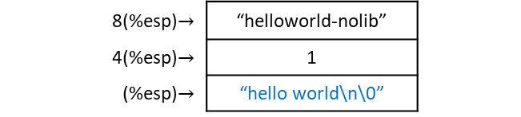
Sharing indefinite # of parameters
.section .data
helloworld:
.ascii "hello world\n\0"
.section .text
.globl _start
_start:
pushl $helloworld
call printf
pushl $0
call exit
8(%esp)$→$ | “helloworld-nolib”
4(%esp)$→$ | 1
(%esp)$→$ | “hello world\n\0”
printf can take an indefinite number of parameters,
here we only have one parameter
prototype
int printf(char *string, ...);

Slide 37
Sharing printf-example.s
.section .data
firststring: # the “format string” (1st parameter) tells printf the number and type of paramenters
.ascii "Hello! %s is a %s who loves the number %d\n\0"
name:
.ascii "Jonathan\0"
personstring:
.ascii "person\0"
numberloved:
.long 3 # could have been an .equ, but decided to give it memory location
.section .text
.globl _start
_start:
# Parameters are passed in reverse order than listed in the function’s prototype
pushl numberloved # this is the %d
pushl $personstring # this is the second %s
pushl $name # this is the first %s
pushl $firststring # this is the format string in the prototype
call printf
pushl $0
call exit
but you can take, for example, four parameters

Slide 38
Sharing printf-example.s
.section .data
firststring: # the “format string” (1st parameter) tells printf the number and type of paramenters
.ascii "Hello! %s is a %s who loves the number %d\n\0"
name:
.ascii "Jonathan\0"
personstring:
.ascii "person\0"
numberloved:
.long 3 # could have been an .equ, but decided to give it memory location
.section .text
.globl _start
_start:
# Parameters are passed in reverse order than listed in the function’s prototype
pushl numberloved # this is the %d
pushl $personstring # this is the second %s
pushl $name # this is the first %s
pushl $firststring # this is the format string in the prototype
call printf
pushl $0
call exit
but you can take, for example, four parameters

Slide 39

Sharing printf-example.s
.section .data
firststring: # the “format string” (1st parameter) tells printf the number and type of paramenters
.ascii "Hello! %s is a %s who loves the number %d\n\0"
name:
.ascii "Jonathan\0"
personstring:
.ascii "person\0"
numberloved:
.long 3 # could have been an .equ, but decided to give it memory location
.section .text
.globl _start
_start:
# Parameters are passed in reverse order than listed in the function’s prototype
pushl numberloved # this is the %d
pushl $personstring # this is the second %s
pushl $name # this is the first %s
pushl $firststring # this is the format string in the prototype
call printf
pushl $0
call exit
4(%esp)$→$ | “printf-example”
(%esp)$→$ | 1

Slide 40
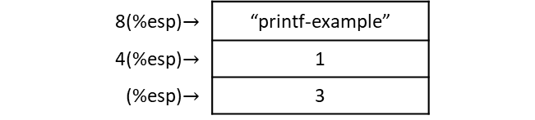
Sharing printf-example.s
.section .data
firststring: # the “format string” (1st parameter) tells printf the number and type of paramenters
.ascii "Hello! %s is a %s who loves the number %d\n\0"
name:
.ascii "Jonathan\0"
personstring:
.ascii "person\0"
numberloved:
.long 3 # could have been an .equ, but decided to give it memory location
.section .text
.globl _start
_start:
# Parameters are passed in reverse order than listed in the function’s prototype
pushl numberloved # this is the %d
pushl $personstring # this is the second %s
pushl $name # this is the first %s
pushl $firststring # this is the format string in the prototype
call printf
pushl $0
call exit
8(%esp)$→$ | “printf-example”
4(%esp)$→$ | 1
(%esp)$→$ | 3

Slide 41
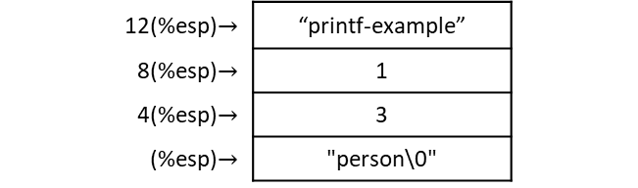
Sharing printf-example.s
.section .data
firststring: # the “format string” (1st parameter) tells printf the number and type of paramenters
.ascii "Hello! %s is a %s who loves the number %d\n\0"
name:
.ascii "Jonathan\0"
personstring:
.ascii "person\0"
numberloved:
.long 3 # could have been an .equ, but decided to give it memory location
.section .text
.globl _start
_start:
# Parameters are passed in reverse order than listed in the function’s prototype
pushl numberloved # this is the %d
pushl $personstring # this is the second %s
pushl $name # this is the first %s
pushl $firststring # this is the format string in the prototype
call printf
pushl $0
call exit
12(%esp)$→$ | “printf-example”
8(%esp)$→$ | 1
4(%esp)$→$ | 3
(%esp)$→$ | "person\0"

Slide 42
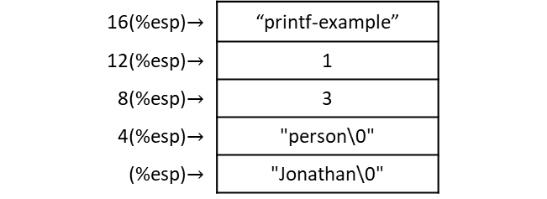
Sharing printf-example.s
.section .data
firststring: # the “format string” (1st parameter) tells printf the number and type of paramenters
.ascii "Hello! %s is a %s who loves the number %d\n\0"
name:
.ascii "Jonathan\0"
personstring:
.ascii "person\0"
numberloved:
.long 3 # could have been an .equ, but decided to give it memory location
.section .text
.globl _start
_start:
# Parameters are passed in reverse order than listed in the function’s prototype
pushl numberloved # this is the %d
pushl $personstring # this is the second %s
pushl $name # this is the first %s
pushl $firststring # this is the format string in the prototype
call printf
pushl $0
call exit
16(%esp)$→$ | “printf-example”
12(%esp)$→$ | 1
8(%esp)$→$ | 3
4(%esp)$→$ | "person\0"
(%esp)$→$ | "Jonathan\0"

Slide 43
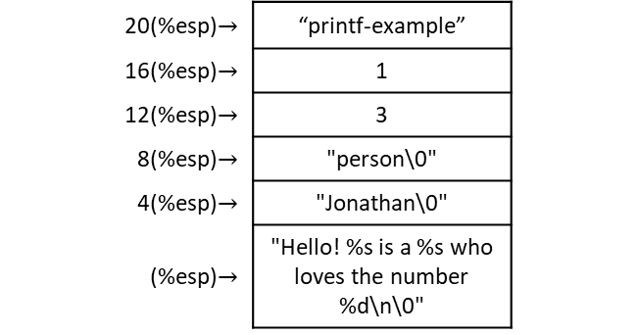
Sharing printf-example.s
.section .data
firststring: # the “format string” (1st parameter) tells printf the number and type of paramenters
.ascii "Hello! %s is a %s who loves the number %d\n\0"
name:
.ascii "Jonathan\0"
personstring:
.ascii "person\0"
numberloved:
.long 3 # could have been an .equ, but decided to give it memory location
.section .text
.globl _start
_start:
# Parameters are passed in reverse order than listed in the function’s prototype
pushl numberloved # this is the %d
pushl $personstring # this is the second %s
pushl $name # this is the first %s
pushl $firststring # this is the format string in the prototype
call printf
pushl $0
call exit
20(%esp)$→$ | “printf-example”
16(%esp)$→$ | 1
12(%esp)$→$ | 3
8(%esp)$→$ | "person\0"
4(%esp)$→$ | "Jonathan\0"
(%esp)$→$ | "Hello! %s is a %s who loves the number %d\n\0"

Slide 44
Sharing printf-example.s
.section .data
firststring: # the “format string” (1st parameter) tells printf the number and type of paramenters
.ascii "Hello! %s is a %s who loves the number %d\n\0"
name:
.ascii "Jonathan\0"
personstring:
.ascii "person\0"
numberloved:
.long 3 # could have been an .equ, but decided to give it memory location
.section .text
.globl _start
_start:
# Parameters are passed in reverse order than listed in the function’s prototype
pushl numberloved # this is the %d
pushl $personstring # this is the second %s
pushl $name # this is the first %s
pushl $firststring # this is the format string in the prototype
call printf
pushl $0
call exit
20(%esp)$→$ | “printf-example”
16(%esp)$→$ | 1
12(%esp)$→$ | 3
8(%esp)$→$ | "person\0"
4(%esp)$→$ | "Jonathan\0"
(%esp)$→$ | "Hello! %s is a %s who loves the number %d\n\0"

Slide 45
Sharing printf-example.s
.section .data
firststring: # the “format string” (1st parameter) tells printf the number and type of paramenters
.ascii "Hello! %s is a %s who loves the number %d\n\0"
name:
.ascii "Jonathan\0"
personstring:
.ascii "person\0"
numberloved:
.long 3 # could have been an .equ, but decided to give it memory location
.section .text
.globl _start
_start:
# Parameters are passed in reverse order than listed in the function’s prototype
pushl numberloved # this is the %d
pushl $personstring # this is the second %s
pushl $name # this is the first %s
pushl $firststring # this is the format string in the prototype
call printf
pushl $0
call exit
20(%esp)$→$ | “printf-example”
16(%esp)$→$ | 1
12(%esp)$→$ | 3
8(%esp)$→$ | "person\0"
4(%esp)$→$ | "Jonathan\0"
(%esp)$→$ | "Hello! %s is a %s who loves the number %d\n\0"
prototype
int printf(char *string, ...);

Slide 46
Sharing printf-example.s
.section .data
firststring: # the “format string” (1st parameter) tells printf the number and type of paramenters
.ascii “Hello! %s is a %s who loves the number %d\n\0"
name:
.ascii "Jonathan\0"
personstring:
.ascii "person\0"
numberloved:
.long 3 # could have been an .equ, but decided to give it memory location
.section .text
.globl _start
_start:
# Parameters are passed in reverse order than listed in the function’s prototype
pushl numberloved # this is the %d
pushl $personstring # this is the second %s
pushl $name # this is the first %s
pushl $firststring # this is the format string in the prototype
call printf
pushl $0
call exit
20(%esp)$→$ | “printf-example”
16(%esp)$→$ | 1
12(%esp)$→$ | 3
8(%esp)$→$ | "person\0"
4(%esp)$→$ | "Jonathan\0"
(%esp)$→$ | "Hello! %s is a %s who loves the number %d\n\0"
prototype
int printf(char *string, ...);
type of value the function will return in %eax when it returns.

Slide 47
Sharing printf-example.s
.section .data
firststring: # the “format string” (1st parameter) tells printf the number and type of paramenters
.ascii "Hello! %s is a %s who loves the number %d\n\0"
name:
.ascii "Jonathan\0"
personstring:
.ascii "person\0"
numberloved:
.long 3 # could have been an .equ, but decided to give it memory location
.section .text
.globl _start
_start:
# Parameters are passed in reverse order than listed in the function’s prototype
pushl numberloved # this is the %d
pushl $personstring # this is the second %s
pushl $name # this is the first %s
pushl $firststring # this is the format string in the prototype
call printf
pushl $0
call exit
20(%esp)$→$ | “printf-example”
16(%esp)$→$ | 1
12(%esp)$→$ | 3
8(%esp)$→$ | "person\0"
4(%esp)$→$ | "Jonathan\0"
(%esp)$→$ | "Hello! %s is a %s who loves the number %d\n\0"
use
printf(char *string, ...);

Slide 48
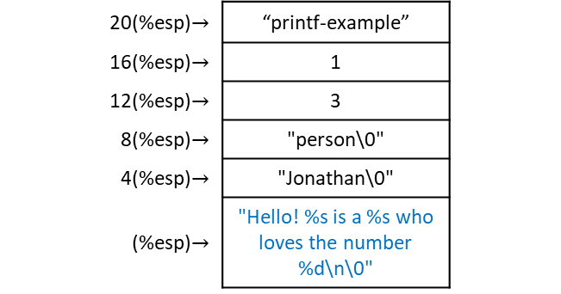
Sharing printf-example.s
.section .data
firststring: # the “format string” (1st parameter) tells printf the number and type of paramenters
.ascii "Hello! %s is a %s who loves the number %d\n\0"
name:
.ascii "Jonathan\0"
personstring:
.ascii "person\0"
numberloved:
.long 3 # could have been an .equ, but decided to give it memory location
.section .text
.globl _start
_start:
# Parameters are passed in reverse order than listed in the function’s prototype
pushl numberloved # this is the %d
pushl $personstring # this is the second %s
pushl $name # this is the first %s
pushl $firststring # this is the format string in the prototype
call printf
pushl $0
call exit
20(%esp)$→$ | “printf-example”
16(%esp)$→$ | 1
12(%esp)$→$ | 3
8(%esp)$→$ | "person\0"
4(%esp)$→$ | "Jonathan\0"
(%esp)$→$ | "Hello! %s is a %s who loves the number %d\n\0"
use
printf("Hello! %s is a %s who loves the number %d\n\0", ...);

Slide 49
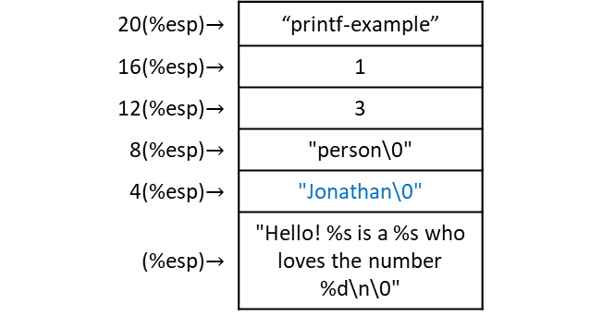
Sharing printf-example.s
.section .data
firststring: # the “format string” (1st parameter) tells printf the number and type of paramenters
.ascii "Hello! %s is a %s who loves the number %d\n\0"
name:
.ascii "Jonathan\0"
personstring:
.ascii "person\0"
numberloved:
.long 3 # could have been an .equ, but decided to give it memory location
.section .text
.globl _start
_start:
# Parameters are passed in reverse order than listed in the function’s prototype
pushl numberloved # this is the %d
pushl $personstring # this is the second %s
pushl $name # this is the first %s
pushl $firststring # this is the format string in the prototype
call printf
pushl $0
call exit
20(%esp)$→$ | “printf-example”
16(%esp)$→$ | 1
12(%esp)$→$ | 3
8(%esp)$→$ | "person\0"
4(%esp)$→$ | "Jonathan\0"
(%esp)$→$ | "Hello! %s is a %s who loves the number %d\n\0"
use
printf("Hello! %s is a %s who loves the number %d\n\0", “Jonathan”, ...);

Slide 50
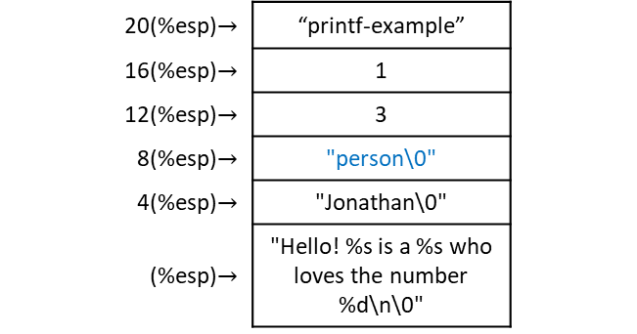
Sharing printf-example.s
.section .data
firststring: # the “format string” (1st parameter) tells printf the number and type of paramenters
.ascii "Hello! %s is a %s who loves the number %d\n\0"
name:
.ascii "Jonathan\0"
personstring:
.ascii "person\0"
numberloved:
.long 3 # could have been an .equ, but decided to give it memory location
.section .text
.globl _start
_start:
# Parameters are passed in reverse order than listed in the function’s prototype
pushl numberloved # this is the %d
pushl $personstring # this is the second %s
pushl $name # this is the first %s
pushl $firststring # this is the format string in the prototype
call printf
pushl $0
call exit
20(%esp)$→$ | “printf-example”
16(%esp)$→$ | 1
12(%esp)$→$ | 3
8(%esp)$→$ | "person\0"
4(%esp)$→$ | "Jonathan\0"
(%esp)$→$ | "Hello! %s is a %s who loves the number %d\n\0"
use
printf("Hello! %s is a %s who loves the number %d\n\0", “Jonathan”, “person”, ...);

Slide 51

Sharing printf-example.s
.section .data
firststring: # the “format string” (1st parameter) tells printf the number and type of paramenters
.ascii "Hello! %s is a %s who loves the number %d\n\0"
name:
.ascii "Jonathan\0"
personstring:
.ascii "person\0"
numberloved:
.long 3 # could have been an .equ, but decided to give it memory location
.section .text
.globl _start
_start:
# Parameters are passed in reverse order than listed in the function’s prototype
pushl numberloved # this is the %d
pushl $personstring # this is the second %s
pushl $name # this is the first %s
pushl $firststring # this is the format string in the prototype
call printf
pushl $0
call exit
20(%esp)$→$ | “printf-example”
16(%esp)$→$ | 1
12(%esp)$→$ | 3
8(%esp)$→$ | "person\0"
4(%esp)$→$ | "Jonathan\0"
(%esp)$→$ | "Hello! %s is a %s who loves the number %d\n\0"
use
printf("Hello! %s is a %s who loves the number %d\n\0", “Jonathan”, “person”, 3);

Slide 52
Sharing printf-example.s
.section .data
firststring: # the “format string” (1st parameter) tells printf the number and type of paramenters
.ascii "Hello! %s is a %s who loves the number %d\n\0"
name:
.ascii "Jonathan\0"
personstring:
.ascii "person\0"
numberloved:
.long 3 # could have been an .equ, but decided to give it memory location
.section .text
.globl _start
_start:
# Parameters are passed in reverse order than listed in the function’s prototype
pushl numberloved # this is the %d
pushl $personstring # this is the second %s
pushl $name # this is the first %s
pushl $firststring # this is the format string in the prototype
call printf
pushl $0
call exit
20(%esp)$→$ | “printf-example”
16(%esp)$→$ | 1
12(%esp)$→$ | 3
8(%esp)$→$ | "person\0"
4(%esp)$→$ | "Jonathan\0"
(%esp)$→$ | "Hello! %s is a %s who loves the number %d\n\0"
prototype
int printf(char *string, ...);
use
printf("Hello! %s is a %s who loves the number %d\n\0", “Jonathan”, “person”, 3);

Slide 53
Sharing printf-example.s
.section .data
firststring: # the “format string” (1st parameter) tells printf the number and type of paramenters
.ascii "Hello! %s is a %s who loves the number %d\n\0"
name:
.ascii "Jonathan\0"
personstring:
.ascii "person\0"
numberloved:
.long 3 # could have been an .equ, but decided to give it memory location
.section .text
.globl _start
_start:
# Parameters are passed in reverse order than listed in the function’s prototype
pushl numberloved # this is the %d
pushl $personstring # this is the second %s
pushl $name # this is the first %s
pushl $firststring # this is the format string in the prototype
call printf
pushl $0
call exit
20(%esp)$→$ | “printf-example”
16(%esp)$→$ | 1
12(%esp)$→$ | 3
8(%esp)$→$ | "person\0"
4(%esp)$→$ | "Jonathan\0"
(%esp)$→$ | "Hello! %s is a %s who loves the number %d\n\0"
prototype
int printf(char *string, ...);
use
printf("Hello! %s is a %s who loves the number %d\n\0", “Jonathan”, “person”, 3);

Slide 54
Sharing printf-example.s
.section .data
firststring: # the “format string” (1st parameter) tells printf the number and type of paramenters
.ascii "Hello! %s is a %s who loves the number %d\n\0"
name:
.ascii "Jonathan\0"
personstring:
.ascii "person\0"
numberloved:
.long 3 # could have been an .equ, but decided to give it memory location
.section .text
.globl _start
_start:
# Parameters are passed in reverse order than listed in the function’s prototype
pushl numberloved # this is the %d
pushl $personstring # this is the second %s
pushl $name # this is the first %s
pushl $firststring # this is the format string in the prototype
call printf
pushl $0
call exit
20(%esp)$→$ | “printf-example”
16(%esp)$→$ | 1
12(%esp)$→$ | 3
8(%esp)$→$ | "person\0"
4(%esp)$→$ | "Jonathan\0"
(%esp)$→$ | "Hello! %s is a %s who loves the number %d\n\0"
prototype
int printf(char *string, ...);
use
printf("Hello! %s is a %s who loves the number %d\n\0", “Jonathan”, “person”, 3);

Slide 55
Sharing printf-example.s
.section .data
firststring: # the “format string” (1st parameter) tells printf the number and type of paramenters
.ascii "Hello! %s is a %s who loves the number %d\n\0"
name:
.ascii "Jonathan\0"
personstring:
.ascii "person\0"
numberloved:
.long 3 # could have been an .equ, but decided to give it memory location
.section .text
.globl _start
_start:
# Parameters are passed in reverse order than listed in the function’s prototype
pushl numberloved # this is the %d
pushl $personstring # this is the second %s
pushl $name # this is the first %s
pushl $firststring # this is the format string in the prototype
call printf
pushl $0
call exit
20(%esp)$→$ | “printf-example”
16(%esp)$→$ | 1
12(%esp)$→$ | 3
8(%esp)$→$ | "person\0"
4(%esp)$→$ | "Jonathan\0"
(%esp)$→$ | "Hello! %s is a %s who loves the number %d\n\0"
prototype
int printf(char *string, ...);
use
printf("Hello! %s is a %s who loves the number %d\n\0", “Jonathan”, “person”, 3);

Slide 56
Sharing printf-example.s
.section .data
firststring: # the “format string” (1st parameter) tells printf the number and type of paramenters
.ascii "Hello! %s is a %s who loves the number %d\n\0"
name:
.ascii "Jonathan\0"
personstring:
.ascii "person\0"
numberloved:
.long 3 # could have been an .equ, but decided to give it memory location
.section .text
.globl _start
_start:
# Parameters are passed in reverse order than listed in the function’s prototype
pushl numberloved # this is the %d
pushl $personstring # this is the second %s
pushl $name # this is the first %s
pushl $firststring # this is the format string in the prototype
call printf
pushl $0
call exit
20(%esp)$→$ | “printf-example”
16(%esp)$→$ | 1
12(%esp)$→$ | 3
8(%esp)$→$ | "person\0"
4(%esp)$→$ | "Jonathan\0"
(%esp)$→$ | "Hello! %s is a %s who loves the number %d\n\0"
prototype
int printf(char *string, ...);
use
printf("Hello! %s is a %s who loves the number %d\n\0", “Jonathan”, “person”, 3);

Slide 57
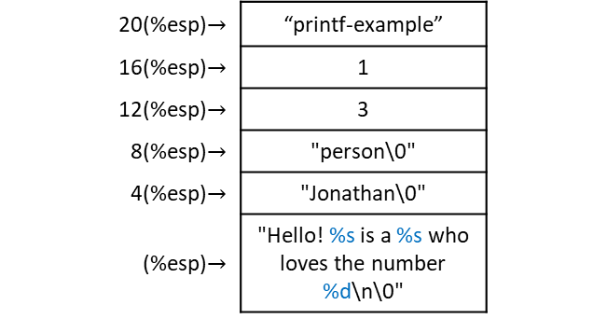
Sharing printf-example.s
.section .data
firststring: # the “format string” (1st parameter) tells printf the number and type of paramenters
.ascii "Hello! %s is a %s who loves the number %d\n\0"
name:
.ascii "Jonathan\0"
personstring:
.ascii "person\0"
numberloved:
.long 3 # could have been an .equ, but decided to give it memory location
.section .text
.globl _start
_start:
# Parameters are passed in reverse order than listed in the function’s prototype
pushl numberloved # this is the %d
pushl $personstring # this is the second %s
pushl $name # this is the first %s
pushl $firststring # this is the format string in the prototype
call printf
pushl $0
call exit
20(%esp)$→$ | “printf-example”
16(%esp)$→$ | 1
12(%esp)$→$ | 3
8(%esp)$→$ | "person\0"
4(%esp)$→$ | "Jonathan\0"
(%esp)$→$ | "Hello! %s is a %s who loves the number %d\n\0"
The parameters pushed in last will be in a known position relative to the top of the stack.
The program can then use these parameters to determine where on the stack the additional
arguments are, and what type they are.
If we pushed the known arguments first, you wouldn’t be able to tell where they were on the stack.
prototype
int printf(char *string, ...);
use
printf("Hello! %s is a %s who loves the number %d\n\0", “Jonathan”, “person”, 3);

Slide 58
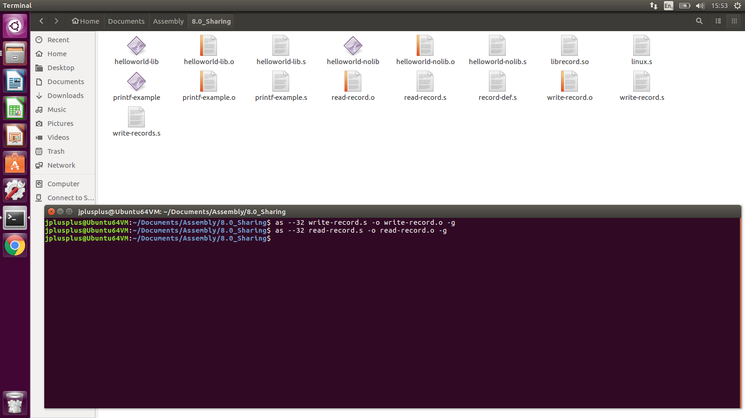
Sharing building a shared library
We can build our code from Chapter 6 into a shared library to use in our programs.

Slide 59
Sharing building a shared library
We can build our code from Chapter 6 into a shared library to use in our programs.
The first thing we would do is assemble them like normal.

Slide 60
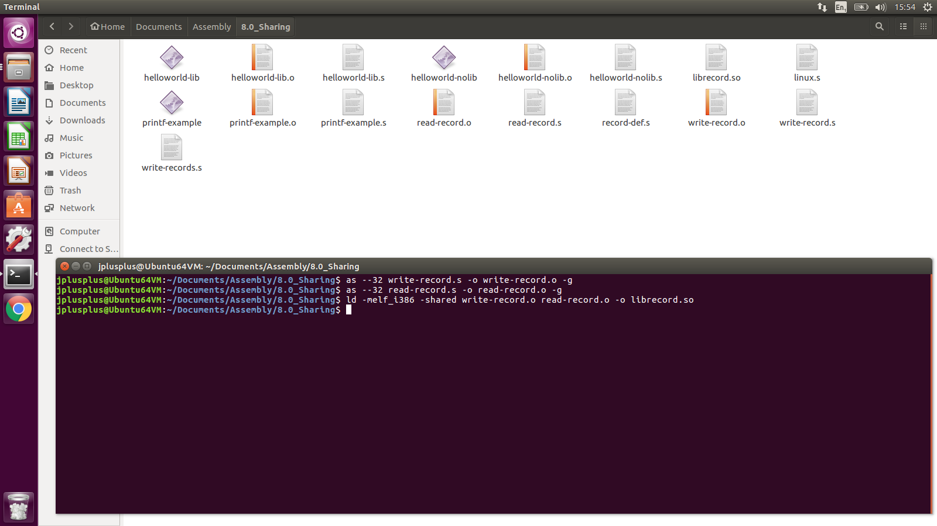
Sharing building a shared library
Instead of linking them into a program, we link them into a shared library (.so: shared object).

Slide 61
Sharing building a shared library
The .so file can be used for multiple programs.
If we update its functions, we just update this one file and not have to worry about which programs use it.

Slide 62
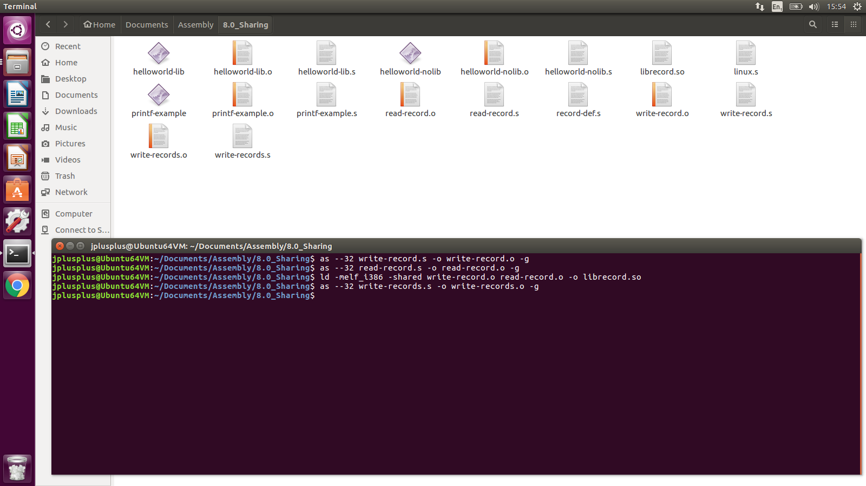
Sharing building a shared library
To link the write-records program, we assemble it

Slide 63

Sharing building a shared library
To link the write-records program, we assemble it and link it.

Slide 64
Sharing building a shared library
To link the write-records program, we assemble it and link it.
The -L . tells linker to find the library in the current directory
(it usually only searches /lib, /usr/lib, and a few others).

Slide 65

Sharing building a shared library
The write-records program is built, but will not run.

Slide 66
Sharing building a shared library
The write-records program is built, but will not run
because, by default, the dynamic linker only searches /lib, /usr/lib,
and whatever directories are listed in /etc/ld.so.conf for libraries.

Slide 67
Sharing building a shared library
The write-records program is built, but will not run
because, by default, the dynamic linker only searches /lib, /usr/lib,
and whatever directories are listed in /etc/ld.so.conf for libraries.
You either need to move the library to one of these directories,

Slide 68
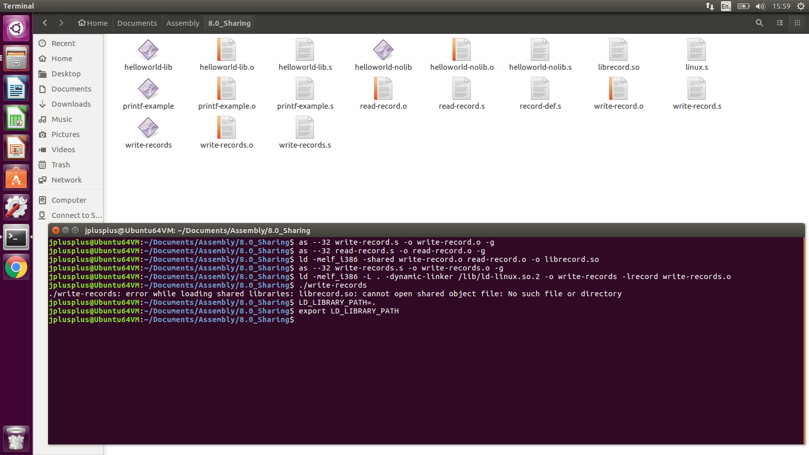
Sharing building a shared library
or execute:
LD_LIBRARY_PATH=.
export LD_LIBRARY_PATH

Slide 69
Sharing building a shared library
or execute:
LD_LIBRARY_PATH=.
export LD_LIBRARY_PATH
This tells the linker to add whatever paths you give it to the library search path for dynamic libraries

Slide 70
Sharing building a shared library
or execute:
LD_LIBRARY_PATH=.
export LD_LIBRARY_PATH
This tells the linker to add whatever paths you give it to the library search path for dynamic libraries
If you get an error, do this instead:
setenv LD_LIBRARY_PATH .

Slide 71
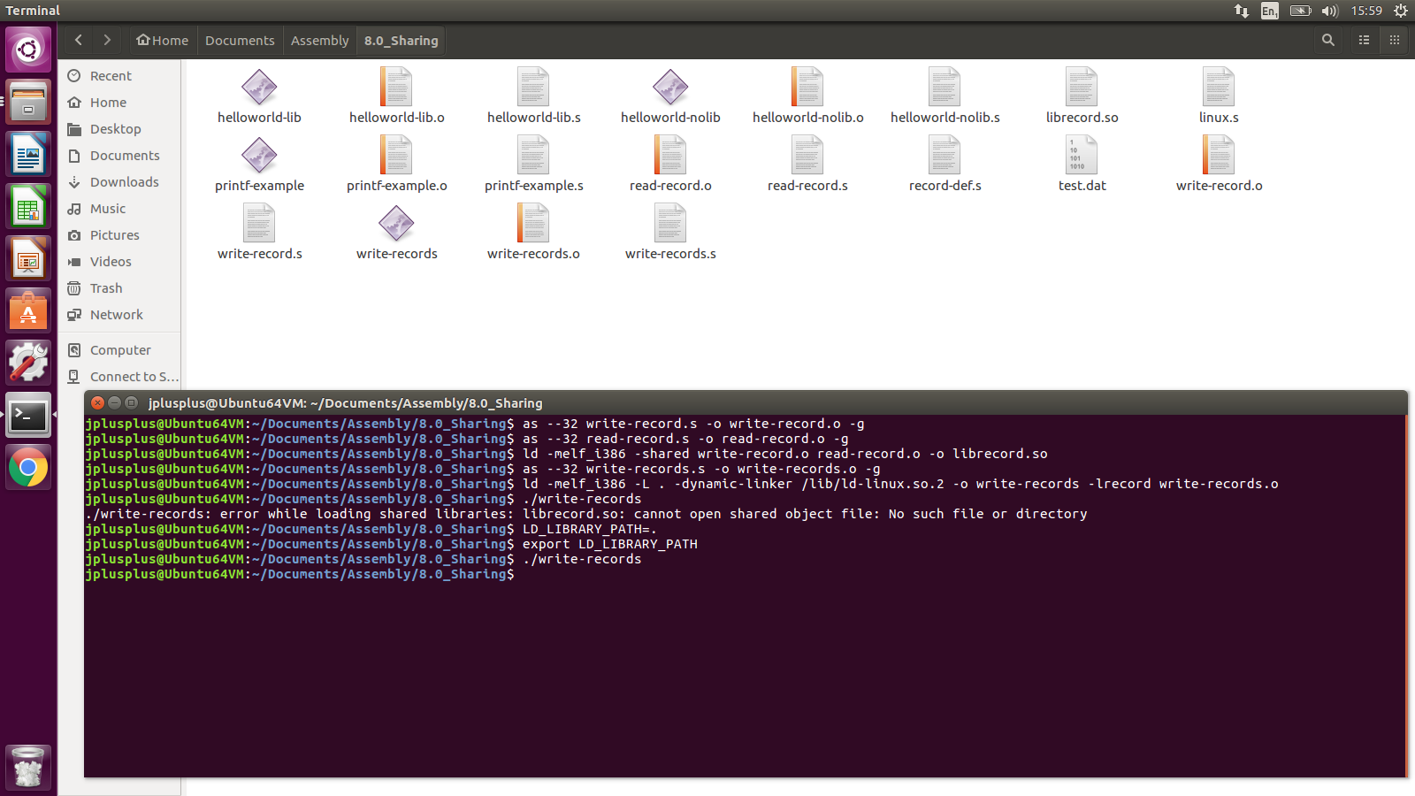
Sharing building a shared library
Now, you can run write-records.

